Slide 1
Outlook and Office Tips and Tricks
Microsoft Tips and Tricks

Slide 2
Change to One Inbox

Slide 3
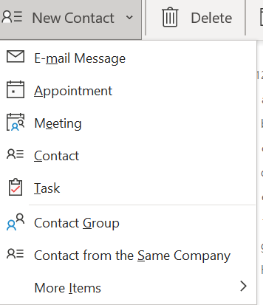
Distribution Lists

Slide 4
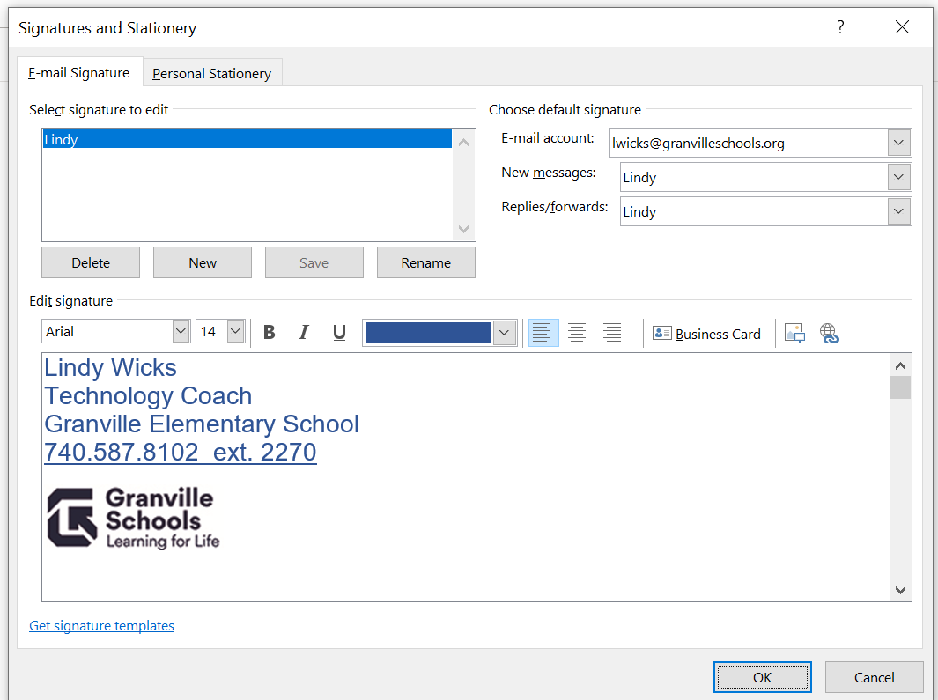
Signatures
Open new mail and select Insert > Signature
Name your signature.
Choose Defaults and create signature.

Slide 5
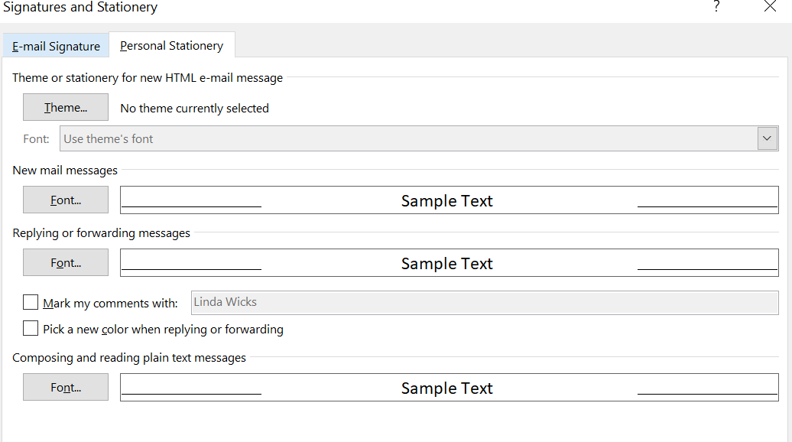
Change Font and Text Size Default
Select File > Options >Mail

Slide 6
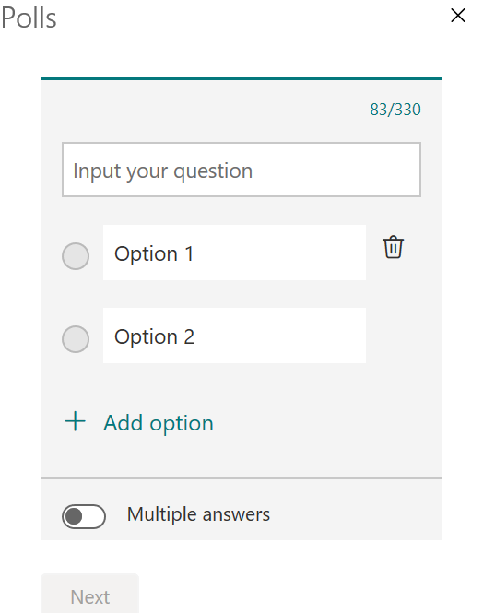
Polls
Open new mail and select Insert > Poll

Slide 7
Quick Parts
Copy frequently used messages and paragraphs to insert into other messages.

Slide 8
In a new message create text and highlight what you want saved. Select Insert.
Choose Quick Parts

Slide 9
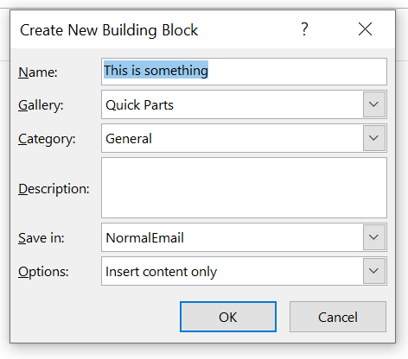
Name your building block
To use in new message select insert and choose which saved building block to use.

Slide 10
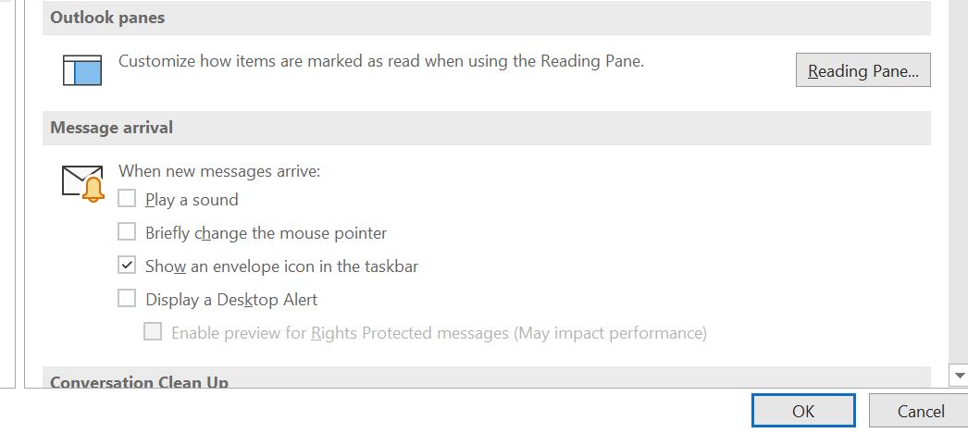
Notifications
Select File>Options>Mail

Slide 11
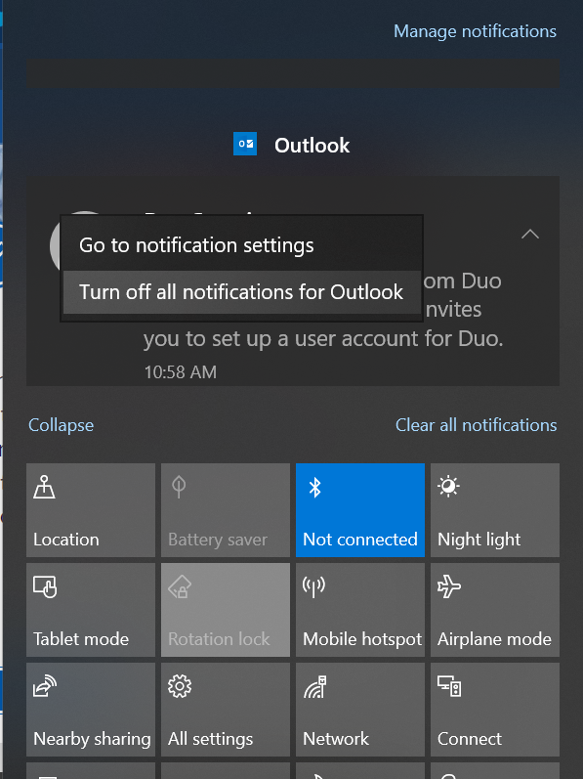
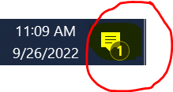
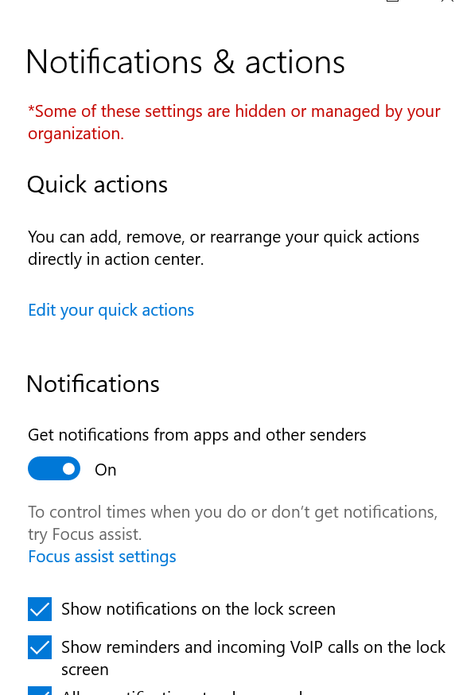
Notifications
Another option to turn off ALL notifications
Click the
icon on the bottom right hand corner ~ right click on an Outlook notification and select turn off all
You may also want to manage ALL notifications.

Slide 12
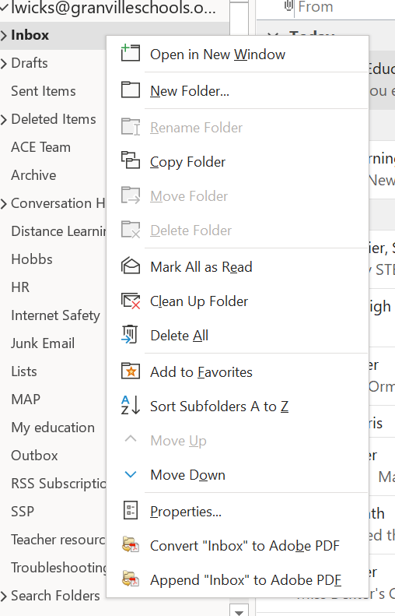
Folders
Drag and drop messages into files.

Slide 13
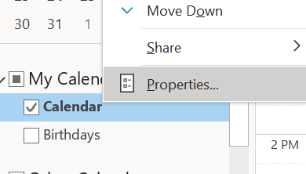
Share Calendar

Slide 14
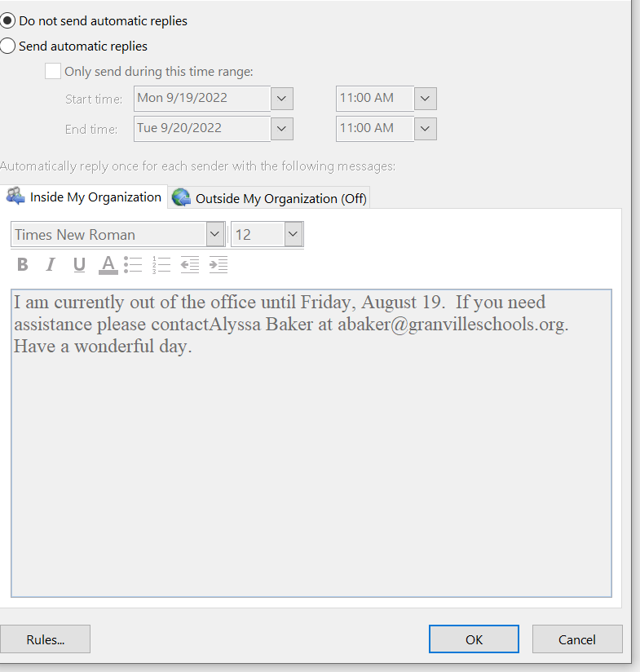
Out of Office Replies
Select File

Slide 15
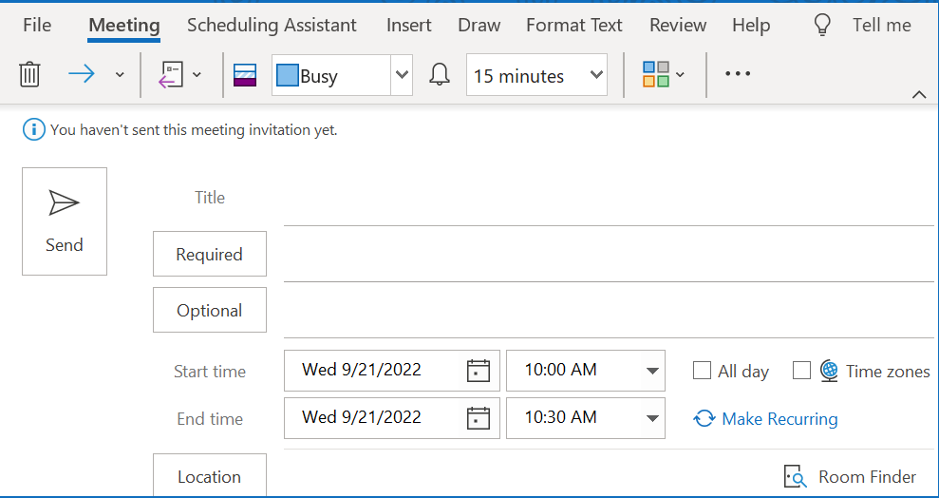
Scheduling Meetings
Select Calendar, click on date on Calendar

Slide 16
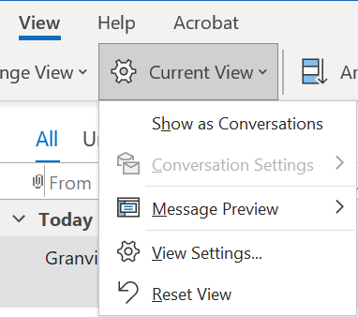
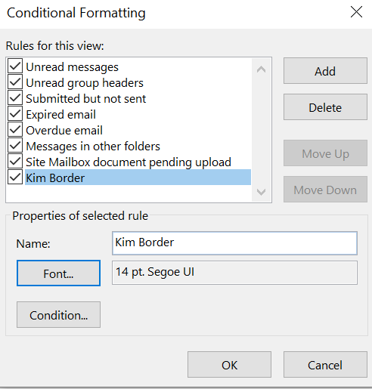
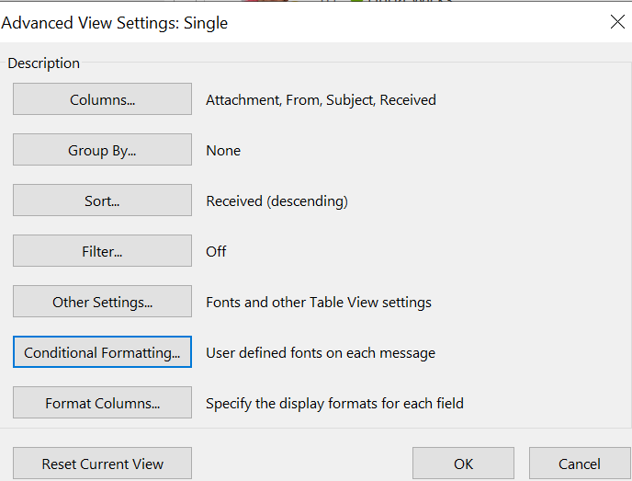
Conditional Formatting
For when you want certain messages to stand out

Slide 17
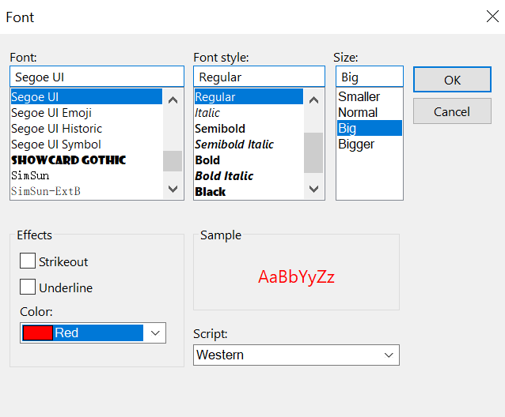
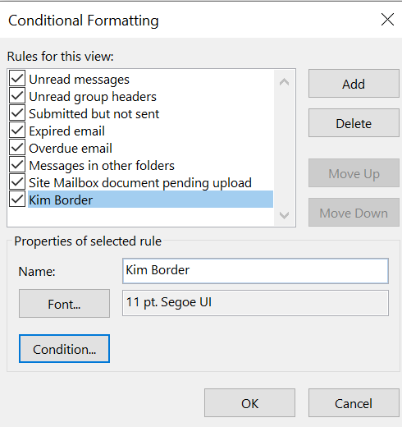
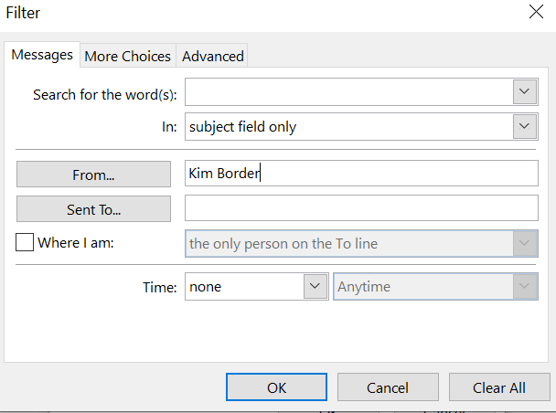

Slide 18
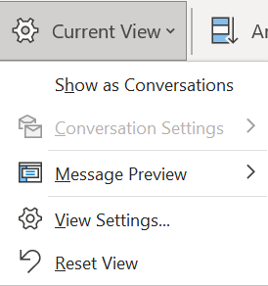
Conversation View
To see all emails in one conversation instead of multiple emails.

Slide 19
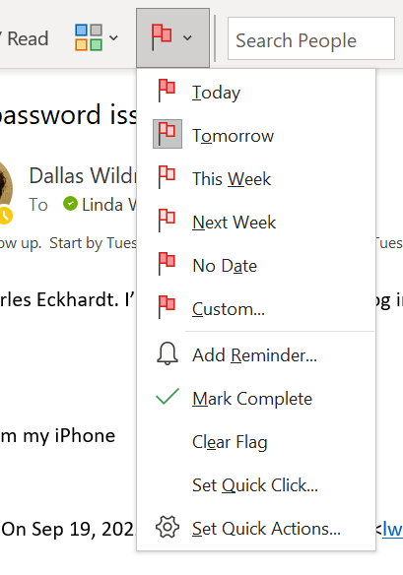
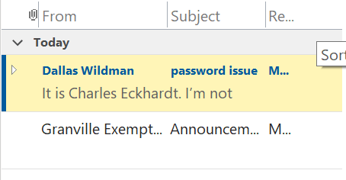
Don't Forget to Follow Up!
Select a message then flag.

Slide 20
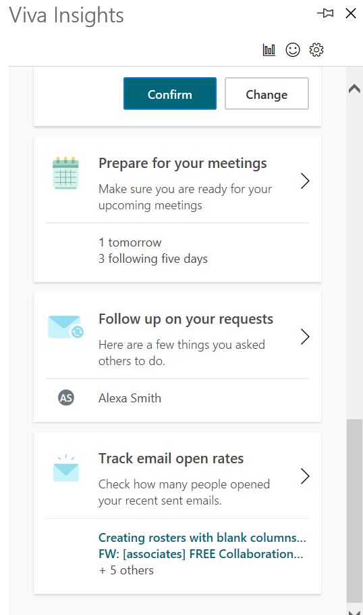
Viva Insights

Slide 21
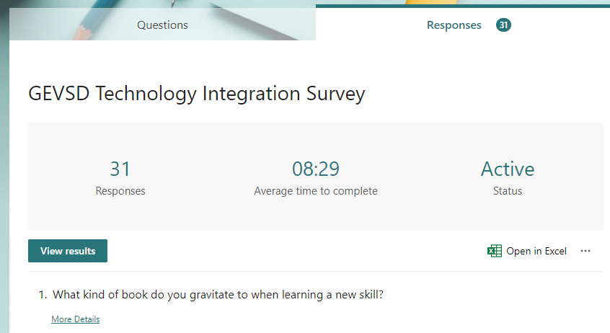
Forms

Slide 22
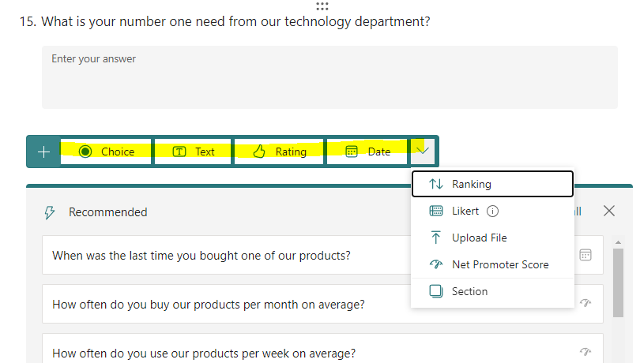
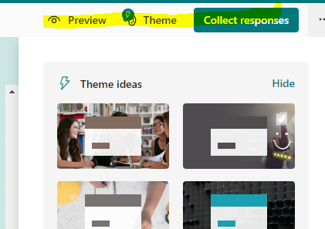
Add questions/ Theme
Click the plus icon to add four types of questions:
Choice, text, rating, date
Various pre-created themes available

Slide 23
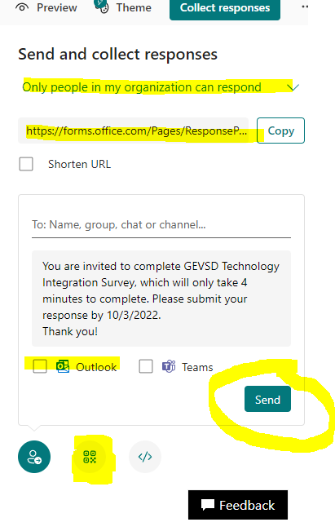
Collect Responses
Send and collect responses FOUR different ways:
URL
Outlook email
QR Code
Embed Code
QR Code
Embeddable Code

Slide 24
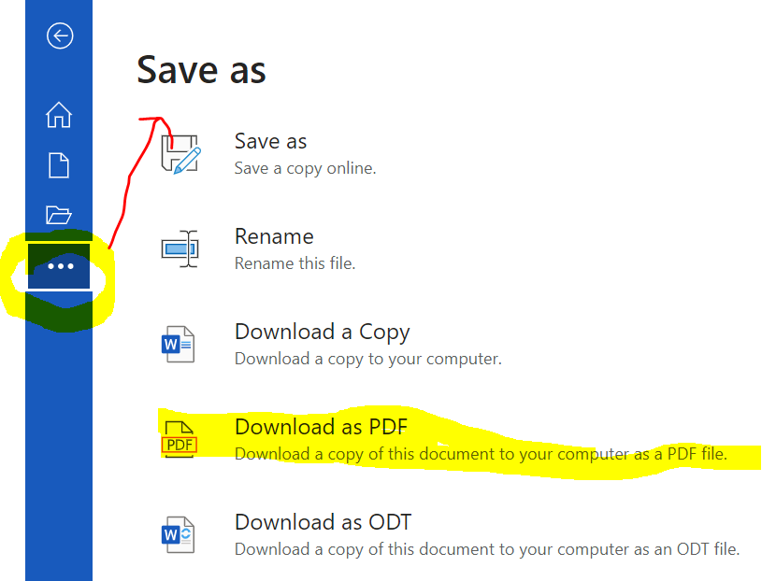
Word Documents
Select save as to save your document as a PDF

Slide 25
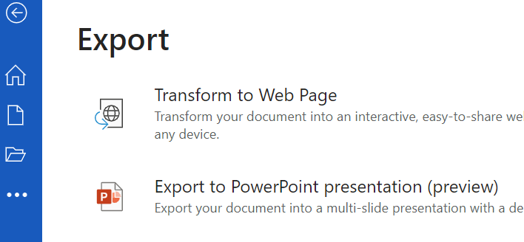
Export to PowerPoint
File ~ Click the

Slide 26
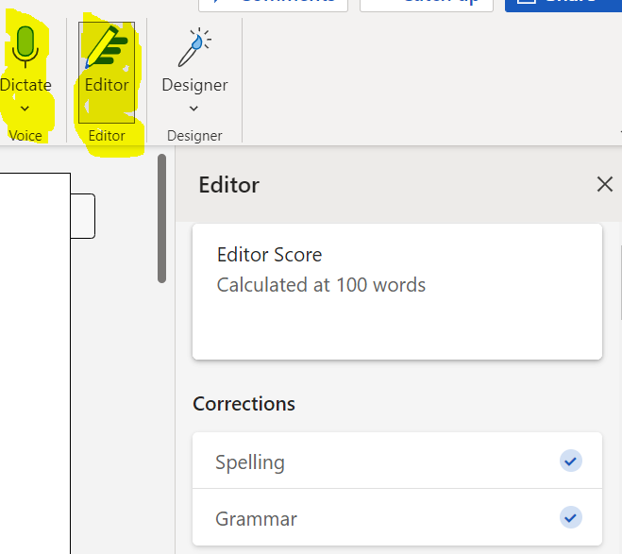
Editor and Dictate
Editor -
Quickly check for corrections and refinements
Option to search for matches with online sources
Dictate -
Dictate text to speech or transcribe

Slide 27
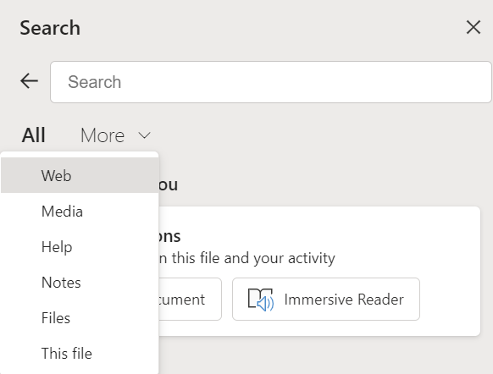
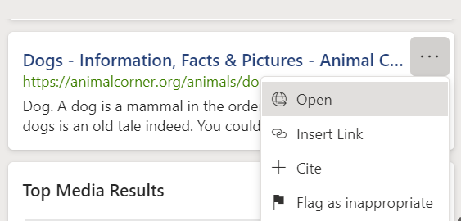
Search on Web with Word

Slide 28
Bringing Technology to Your Classroom
Flip
Book Creator
Microscopes
Keyboarding
Office 365
Pear Deck
Etc.

